Slide 1
BOF Session: Science Platforms
Gerard Lemson
Johns Hopkins University
sciserver.org

Slide 2
BOF Motivation
How users will interact with the data in the future is uncertain
SciServer aims to address this problem by providing format agnostic storage with core access and processing tools that are extensible to new developments and research goals.
Discuss interaction of Notebooks, VO Services, and graphical portals for data discovery
SciServer supports Jupyter Notebooks with Python, R, Matlab as well an R-Studio UI. We also support executing raw scripts. This is integrated through a basic UI that manages the core processes of: 1) Specifying the script/job to run 2) plugging in the data to be accessed/processed 3) Providing feedback on job execution and access to final results.
We are not using VO-Services, but we developed the system using VO-URP, a spin-off of IVOA Simulation DM effort.
How do we deal with batch Processing – large jobs
We use a custom job scheduler that supports configurable job types for compute and query. The architecture is a PULL system whereby “COMPMs” run on server clusters (“Domains”) with the resources to support jobs of varying sizes. Users can be both registered to access, and select, different domains.
How do we manage resources/quotas(disk/memory/CPU)
Our Systems Group manages our hardware. TBD: implement quota and retention policies for persistent and scratch storage (file and database). Actual quotas will be evaluated continuously and policies updated as we understand usage. We also have extensive monitoring tools to see what processes are using CPU/Ram to identify abuse. Our Server-VM-Docker setup also allows us to partition CPU and RAM usage as part of the execution Domain
How can we enable users to share their work
Our RACM component is designed for resource management and access controls, which enable complex sharing scenarios to be realized. We can share many resources including Folders, Databases, Volume Containers, Docker Images, and in future Database Tables and single Files.
…And create ad-hoc Scientific Collaborations
We are implementing a “Workspace” concept that greatly simplifies collaboration by providing a base level of storage (file and database) to a Workspace, and making it easy to add in new shared resources and new User members – automatically sharing resources with them.

Slide 3
What is SciServer
DATA: A system for researchers across multiple science domains to host and share datasets
ANALYSIS: Provide query and analysis tools for advanced processing
SHARING: Provide tools to support collaborative research
SCALABILITY: Distributed deployment

Slide 4
Major Features
Science data hosting (files and databases)
SQL query access
Analysis with Jupyter notebooks hosted in Docker Containers
Interactive and batch job submission
Collaboration and sharing
Resource access controls
Personal storage (files and database)
API access
Single sign-on
Managed hardware Infrastructure in IDIES

Slide 5
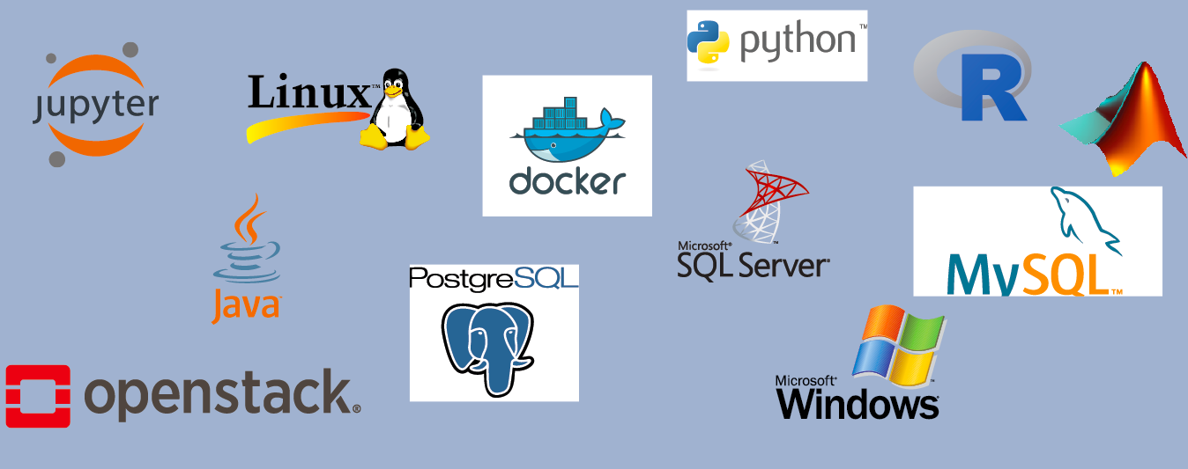
Technologies

Slide 6
System View

Slide 7
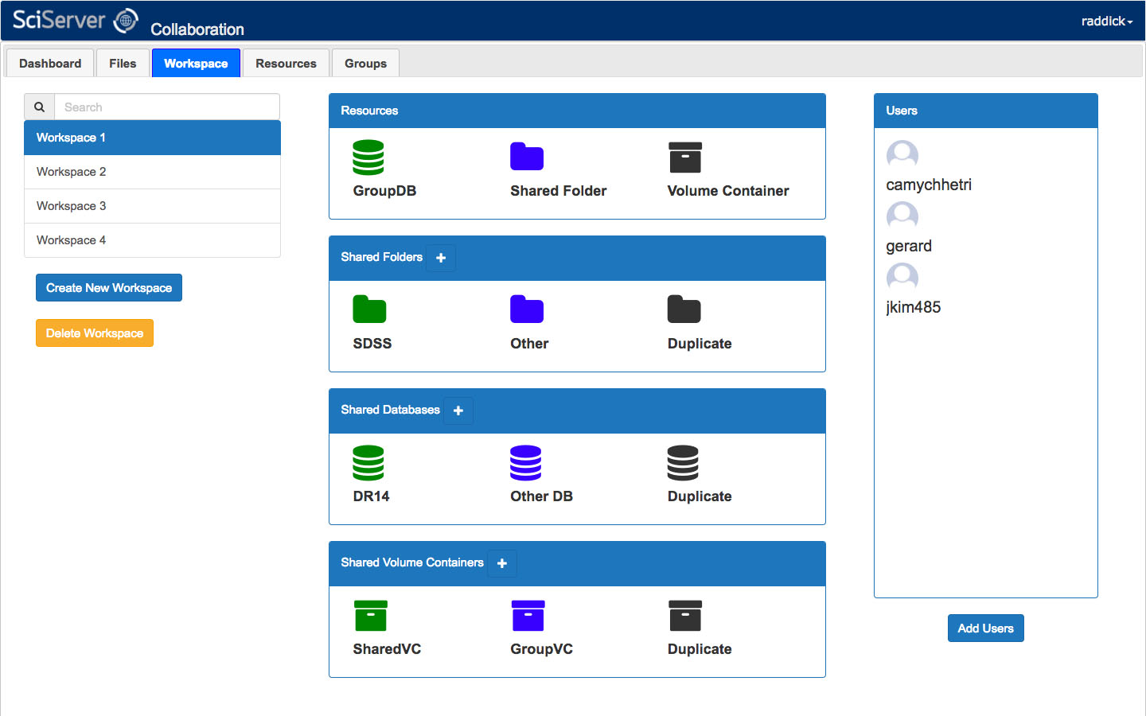
Collaborative Workspaces
(In development)

Slide 8
Science Collaborations

Slide 9
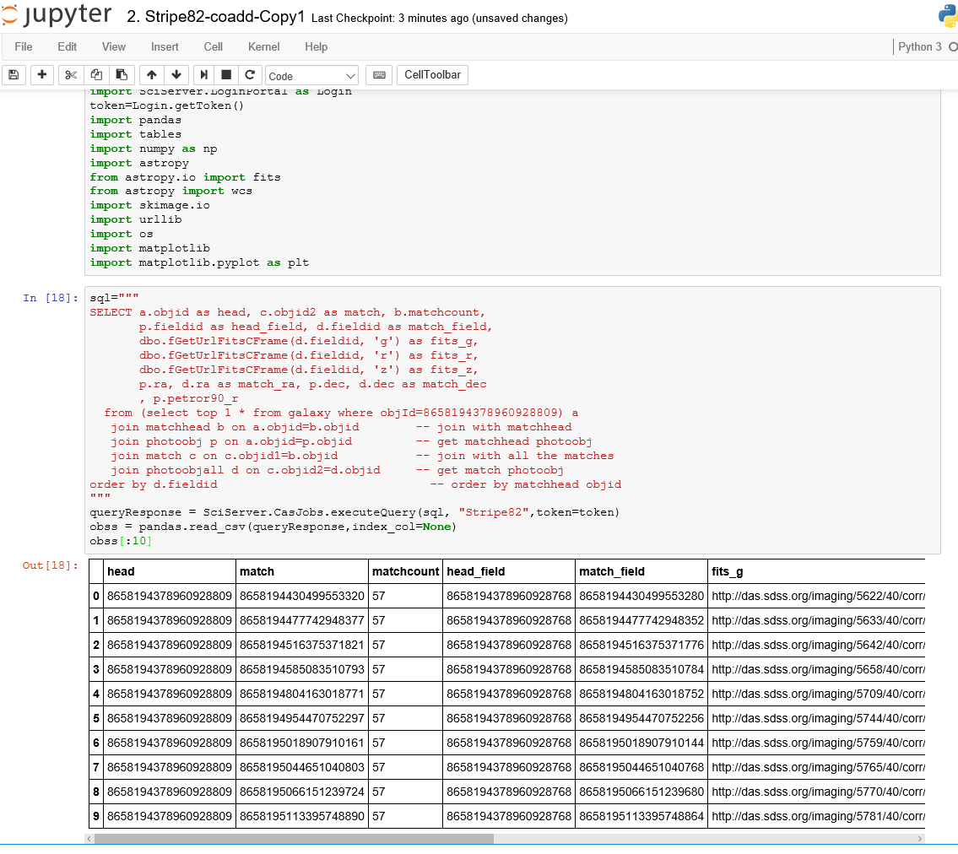
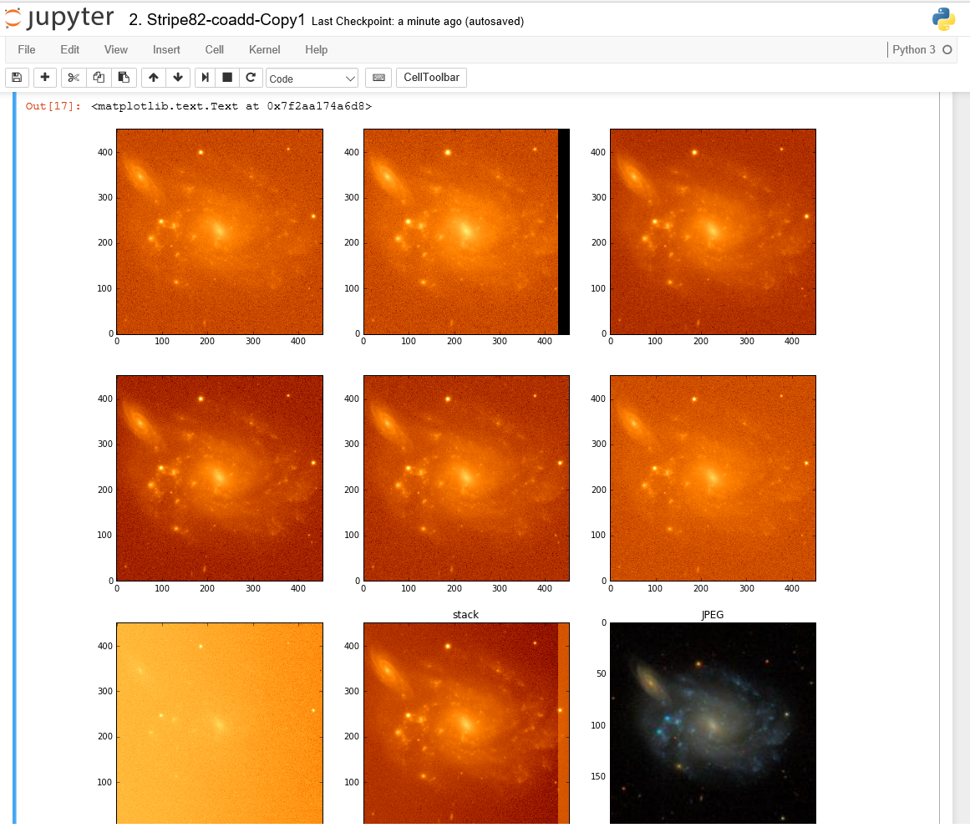
CAS + DAS
Demo
Notes:
Query database from Sloan Digital Sky Survey with 100s of millions of galaxies, and retrieve the images they were detected in from auto-mounted file system (~80TB). Analyze all in python notebook.

Slide 10
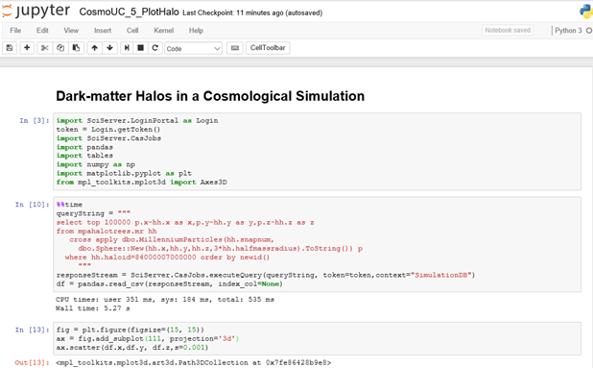
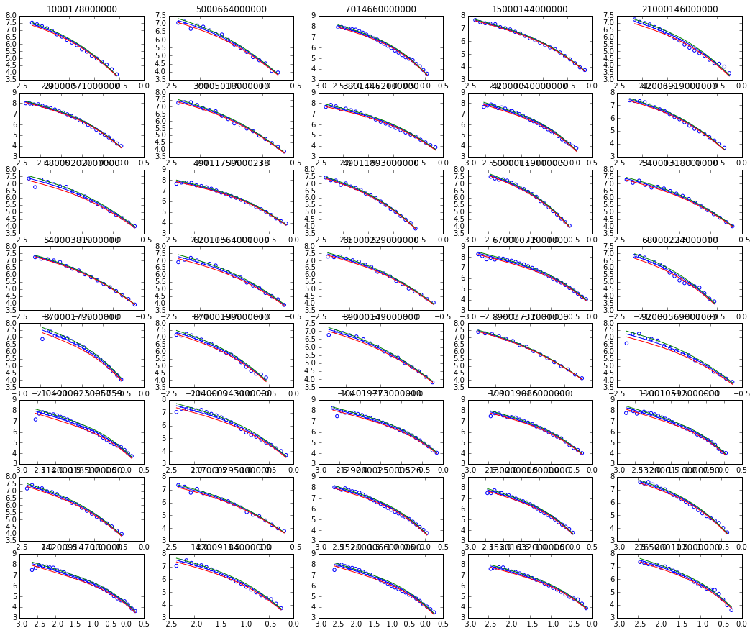
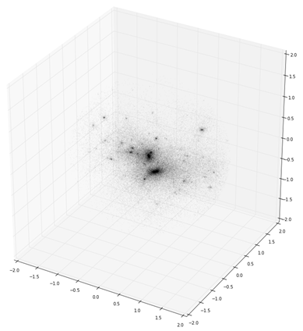
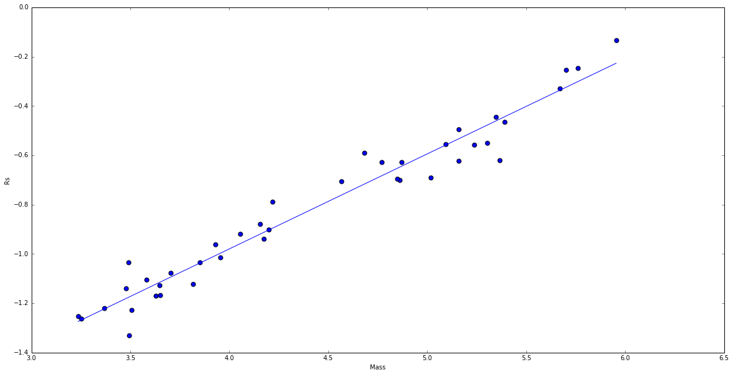
Demo
Notes:
Analyze the properties and scaling characteristics of dark matter halos in cosmological simulations.
Querying their constituents from raw data consisting of 10 billion particles, all server-side, to determine density profiles and fit these to standard models. Extends RDB technology to allow querying of raw data files from within SQL queries: FileDB.

Slide 11
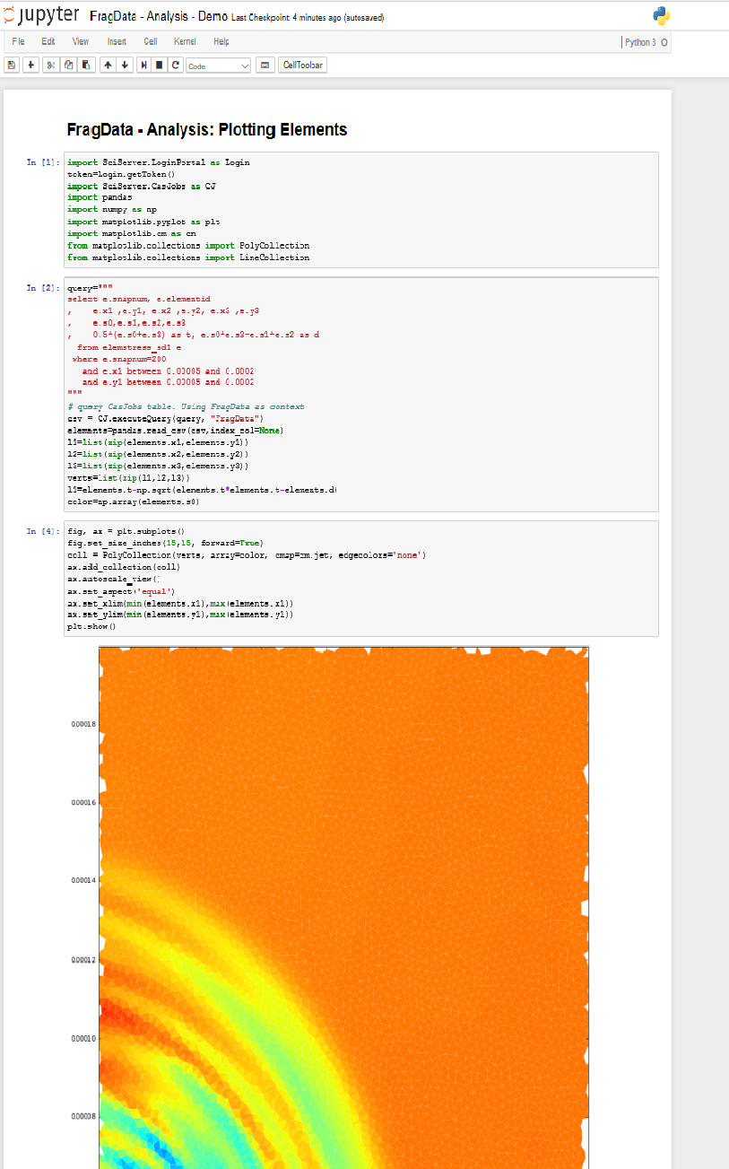
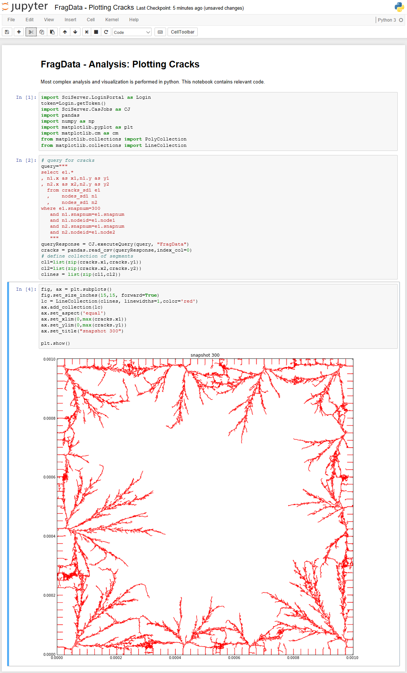
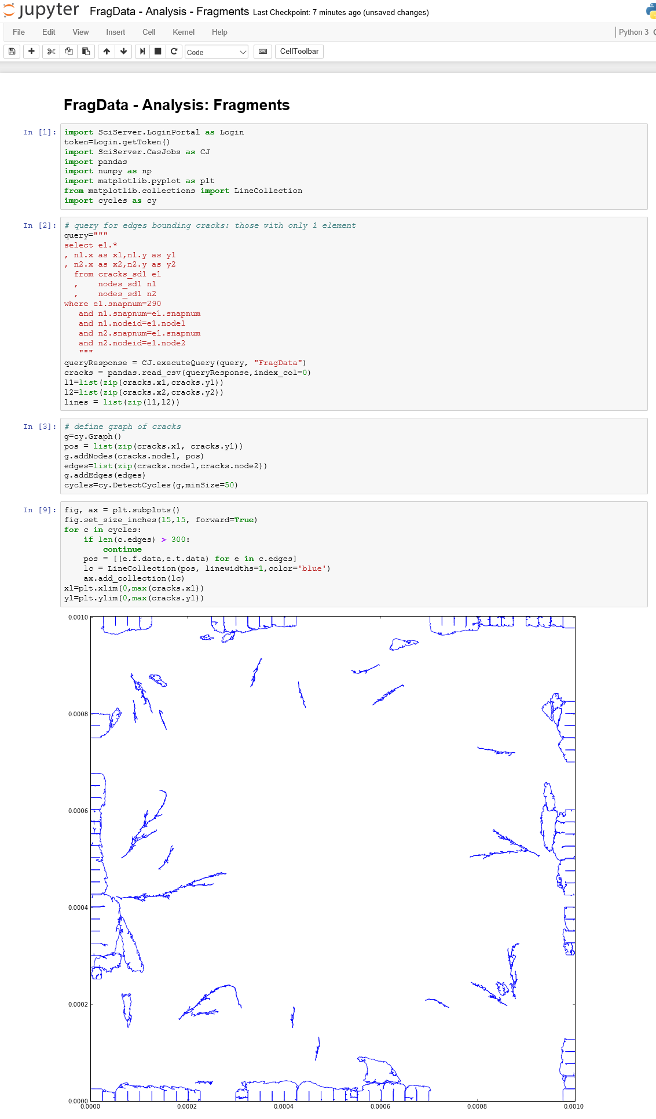
Demo
Notes:
Query and analyze simulations of fragmentation of 2-dimensional materials under external stress.
An example of using RDB technology for very different field. And use of python code to do more complex analysis (detecting cycles in graphs).

Slide 12
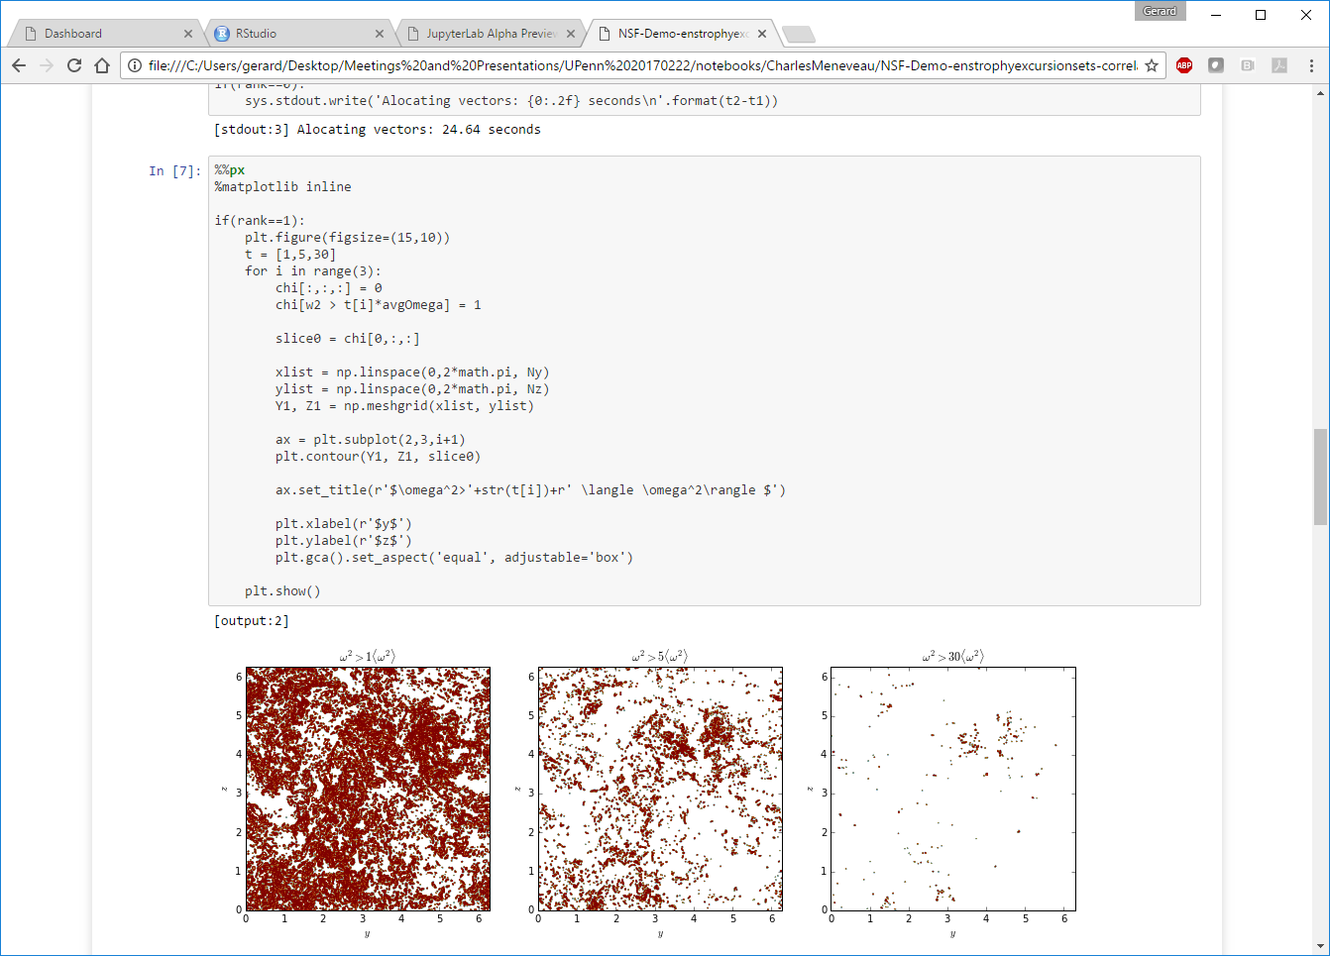
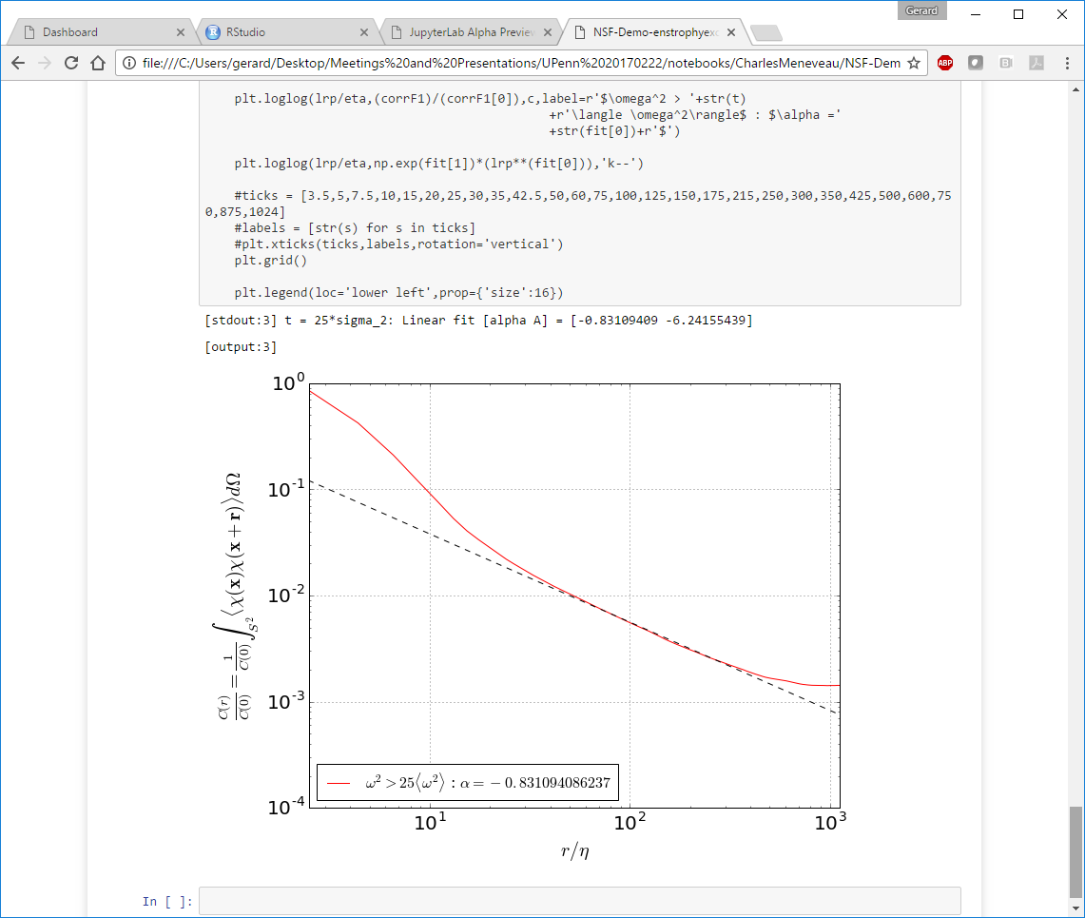

Slide 13
